Slide 1
Price Prediction of Airbnb listings
Supervised by: Dr. Yuan Tian
Group No.2
Salma Mohamed Maher
Yasmin gamal Mohamed

Slide 2
AGENDA
Introduction
Motivation
Dataset Statistics
Methodology

Slide 3
Introduction:
Airbnb is an online community marketplace that connects people looking to rent their homes with people who are looking for accommodations.
This dataset focuses on Airbnb listings and activities in New York City, a prime destination for both tourists and business travelers.

Slide 4
Motivation:
The primary goal of analyzing this dataset is to gain insights related to pricing and guest satisfaction. This can help hosts optimize their listings, guests find suitable accommodations, and Airbnb as a platform to enhance its services.

Slide 5
Dataset Statistics:
The dataset is a collection of Airbnb listings. It contains various attributes related to Airbnb properties, hosts, and user interactions.
The Airbnb dataset consists of 102,599 entries and 28 features.
Key Features of the Dataset:
Listings details
Geographical Information
Pricing Information
Booking and Availability
Review Information

Slide 6
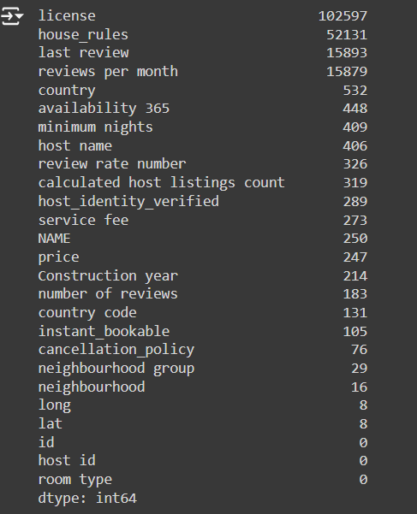
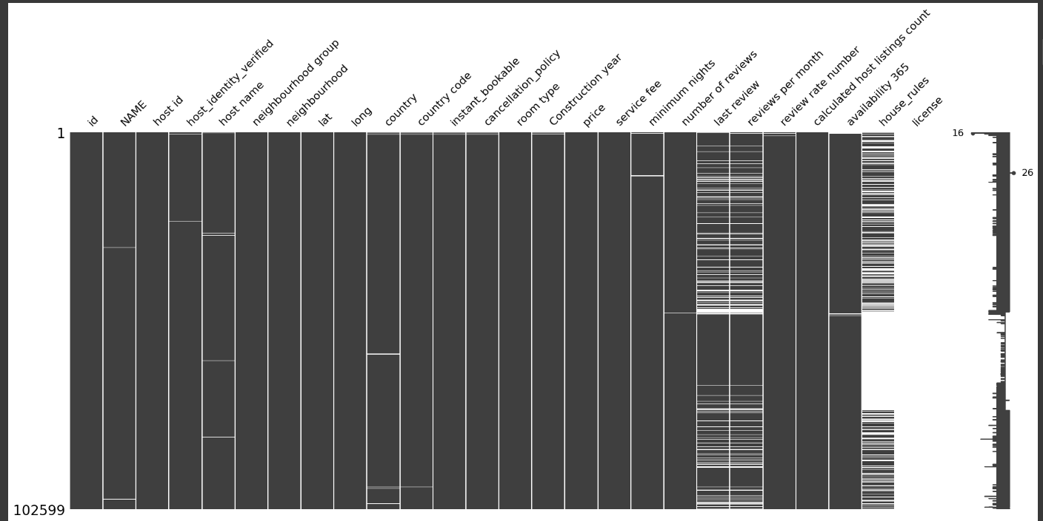
Methodology:
Data Cleaning and Preparation.
Handling Missing Values:

Slide 7
1-Mean/Median Imputation
Price
Service Fee Column
Number of reviews
2-Mode Imputation
Review rate number
3-Deletion
License (it has only 2 values and all other values are missing)
Country-Country Code (they have only one unique value)
Id, host-id, host name

Slide 8
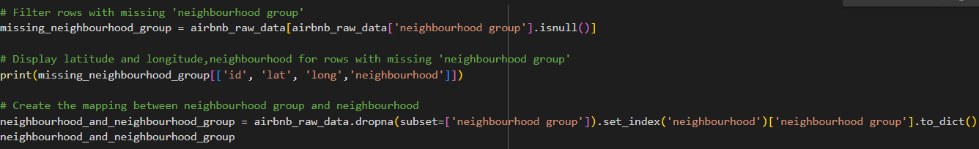
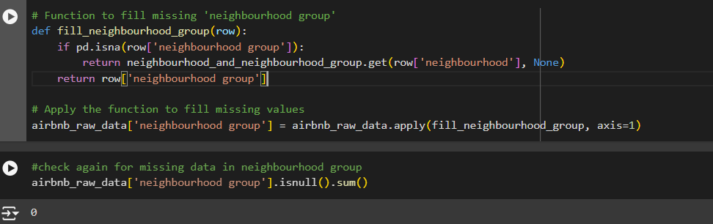
4-Imputation Based on Existing Relationships
Calculated host listings count Column
Neighborhood group Column

Slide 9
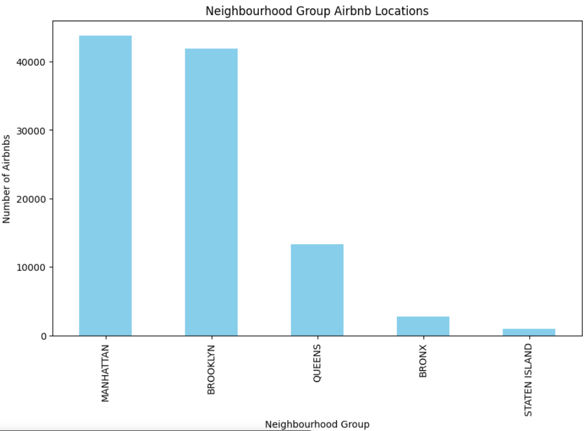
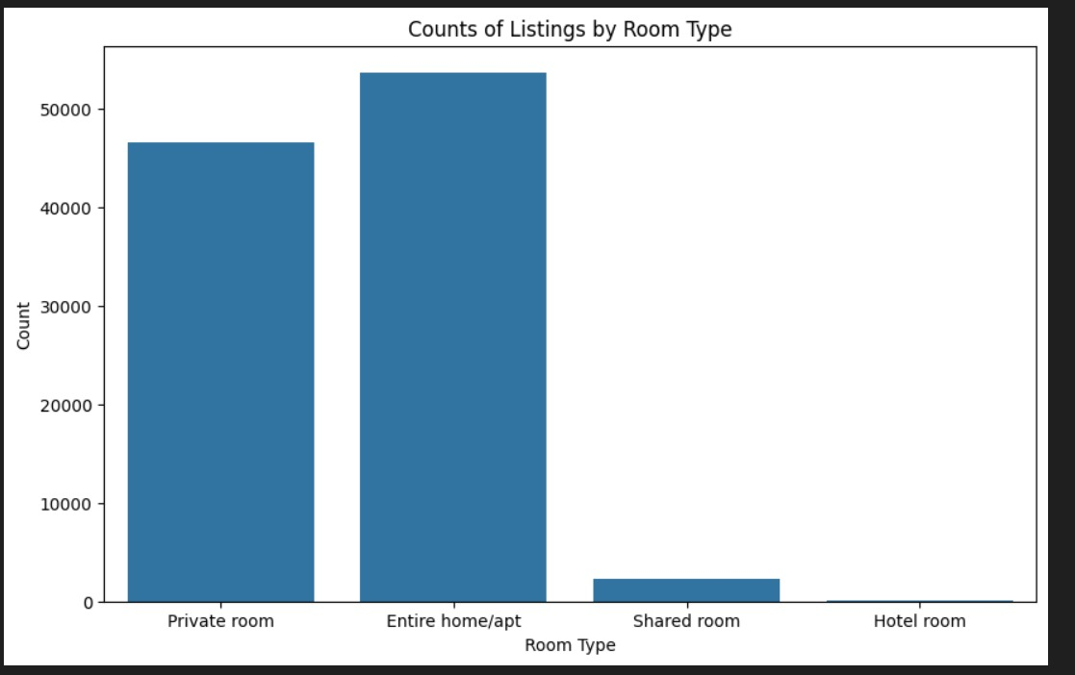
2-Data Visualization
2- what is the distribution of room types?
1- What is the distribution of listings across different neighbourhood groups?

